Slide 2
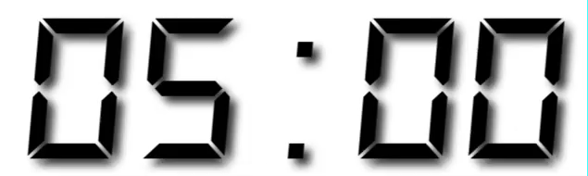
Your Turn
Re-introduce yourself to the people at your table. Then login to your rstudio.cloud project.

Slide 3
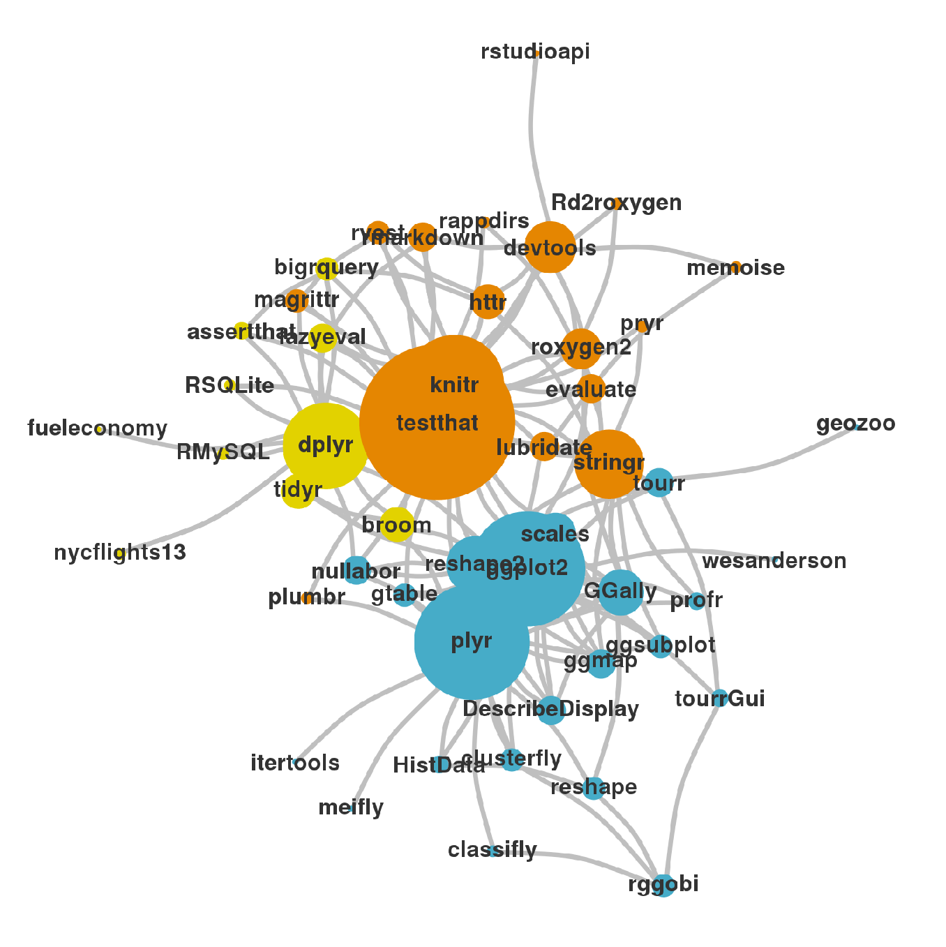

Import data into software
Collect
Data
Tidy data into useable form
Design Experiment
Explore or Test
Form Hypothesis
Transform the data. Do feature engineering.
Deploy app or publish paper
Write code to apply a modeling algorithm.
Build app or write paper
Visualize the data and/or results
Communicate Results
CC BY-SA RStudio

Slide 4
(Applied) Data Science
Import data into software
Collect
Data
Tidy data into useable form
Design Experiment
Explore or Test
Visualize
Form Hypothesis
Transform the data. Do feature engineering.
Import
Tidy
Model
Communicate
Transform
Deploy app or publish paper
Write code to apply a modeling algorithm.
Program
Build app or write paper
Visualize the data and/or results
Communicate Results
CC BY-SA RStudio

Slide 5

Tidy data
country | year | cases | pop
Afghanistan | 1999 | 745 | 19987071
Afghanistan | 2000 | 2666 | 20595360
Brazil | 1999 | 37737 | 172006362
Brazil | 2000 | 80488 | 174504898
China | 1999 | 212258 | 1272915272
China | 2000 | 213766 | 1280428583
A data set is tidy iff:
Each variable is in its own column
Each case is in its own row
Each value is in its own cell

Slide 6
Tidy tools
country | year | cases | pop
Afghanistan | 2000 | 2666 | 20595360
Brazil | 2000 | 80488 | 174504898
China | 2000 | 213766 | 1280428583
country | year | cases | pop
Afghanistan | 1999 | 745 | 19987071
Afghanistan | 2000 | 2666 | 20595360
Brazil | 1999 | 37737 | 172006362
Brazil | 2000 | 80488 | 174504898
China | 1999 | 212258 | 1272915272
China | 2000 | 213766 | 1280428583
filter(df, year == 2000)

Slide 7
Tidy tools
country | cases | pop
Afghanistan | 2666 | 20595360
Brazil | 80488 | 174504898
China | 213766 | 1280428583
country | year | cases | pop
Afghanistan | 2000 | 2666 | 20595360
Brazil | 2000 | 80488 | 174504898
China | 2000 | 213766 | 1280428583
filter(df, year == 2000)
select(df, -year)

Slide 8
Tidy tools
country | cases | pop
Afghanistan | 2666 | 20595360
Brazil | 80488 | 174504898
China | 213766 | 1280428583
country | cases | pop | rate
Afghanistan | 2666 | 20595360 | 0.00013
Brazil | 80488 | 174504898 | 0.00046
China | 213766 | 1280428583 | 0.00017
filter(df, year == 2000)
select(df, -year)
mutate(df, rate = cases / pop)

Slide 9
Tidy tools
country | cases | pop | rate
Afghanistan | 2666 | 20595360 | 0.00013
Brazil | 80488 | 174504898 | 0.00046
China | 213766 | 1280428583 | 0.00017
filter(df, year == 2000)
select(df, -year)
mutate(df, rate = cases / pop)
summarise(df, avg = mean(rate))
avg
0.00025

Slide 10
Tidy tools
country | cases | pop | rate
Afghanistan | 2666 | 20595360 | 0.00013
Brazil | 80488 | 174504898 | 0.00046
China | 213766 | 1280428583 | 0.00017
df %>%
filter(year == 2000) %>%
select(-year) %>%
mutate(rate = cases / pop) %>%
summarise(avg = mean(rate))
avg
0.00025

Slide 11




Today
Functions for specific types of data.
strings
factors
dates
times
CC BY-SA RStudio

Slide 12
Non-Tidy R
Lists
Models
$city
[1] "New York" "New York" "London"
[4] "London" "Beijing" "Beijing"
$size
[1] "large" "small" "large" "small"
[5] "large" "small"
$amount
[1] 23 14 22 16 121 121
attr(,"row.names")
[1] 1 2 3 4 5 6
Call:
lm(formula = lifeExp ~ year, data = gapminder)
Residuals:
Min 1Q Median 3Q Max
-39.949 -9.651 1.697 10.335 22.158
Coefficients:
Estimate Std. Error t value Pr(>|t|)
(Intercept) -585.65219 32.31396 -18.12 <2e-16 ***
year 0.32590 0.01632 19.96 <2e-16 ***
---
Signif. codes: 0 ‘***’ 0.001 ‘**’ 0.01 ‘*’ 0.05 ‘.’ 0.1 ‘ ’ 1
Residual standard error: 11.63 on 1702 degrees of freedom
Multiple R-squared: 0.1898, Adjusted R-squared: 0.1893
F-statistic: 398.6 on 1 and 1702 DF, p-value: < 2.2e-16

Slide 13
List Columns
A table is …an organizational structure …that you can manipulate.
country | r.squared | data | model
Botswana | 0.03
Lesotho | 0.08
Rwanda | 0.02
year | .resid
1952 | -5.3071154
1957 | -3.6144580
1962 | -2.0158007
1967 | -0.5411434
1972 | 1.8815140
1977 | 4.8731713
1982 | 6.7348287
1987 | 8.5694860
1992 | 7.3891434
1997 | -3.1031993
2002 | -9.3285420
2007 | -5.5378846
Call:
lm(formula = lifeExp ~ year, data = .)
Coefficients:
(Intercept) year
-65.49586 0.06067
year | .resid
1952 | -5.2410256
1957 | -2.8098543
1962 | -0.5876830
1967 | -0.3205117
1972 | 0.4766597
1977 | 2.4398310
1982 | 4.8320023
1987 | 6.4561737
1992 | 8.4833450
1997 | 3.8785163
2002 | -7.5643124
2007 | -10.0431410
Call:
lm(formula = lifeExp ~ year, data = .)
Coefficients:
(Intercept) year
-139.16529 0.09557
CC BY-SA RStudio
year | .resid
1952 | -2.7419487
1957 | -1.0127914
1962 | 0.7163660
1967 | 2.0455233
1972 | 2.7746807
1977 | 3.4038380
1982 | 4.8509953
1987 | 2.8821527
1992 | -17.3096900
1997 | -4.5925326
2002 | 2.9626247
2007 | 6.0207821
Call:
lm(formula = lifeExp ~ year, data = .)
Coefficients:
(Intercept) year
-139.16529 0.09557

Slide 14
"Data Science"
Design Experiment
Form Hypothesis
Collect
Data
Communicate Results
Explore or Test
CC BY-SA RStudio

Slide 15
Import data into software
Collect
Data
Tidy data into useable form
Design Experiment
Explore or Test
Form Hypothesis
Transform the data. Do feature engineering.
Deploy app or publish paper
Write code to apply a modeling algorithm.
Build app or write paper
Visualize the data and/or results
Communicate Results
CC BY-SA RStudio

Slide 16
(Applied) Data Science
Import data into software
Collect
Data
Tidy data into useable form
Design Experiment
Explore or Test
Visualize
Form Hypothesis
Transform the data. Do feature engineering.
Import
Tidy
Model
Communicate
Transform
Deploy app or publish paper
Write code to apply a modeling algorithm.
Program
Build app or write paper
Visualize the data and/or results
Communicate Results
CC BY-SA RStudio
CC by RStudio

Slide 17
Tidy tools
Tidy functions are:
Simple - They do one thing, and they do it well
Composable - They can be combined with other functions for multi-step operations
Smart - They can use R objects as input.
Tidy functions also expect and return tidy data.
CC BY-SA RStudio

Slide 18
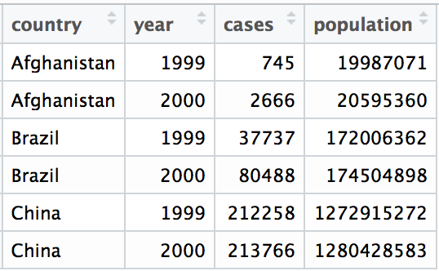
Tidy data
A data set is tidy iff:
It is a data frame (e.g. tibble)
Each variable is in its own column
Each case is in its own row
CC BY-SA RStudio

Slide 19
"Better experimental design = simpler statistics.
Better data model = simpler analysis."
- Jenny Bryan (2016)

Slide 20
(Applied) Data Science
Visualize
Import
Tidy
Model
Communicate
Transform
Program
CC BY-SA RStudio

Slide 21
(Applied) Data Science
Visualize
Import
Tidy
Model
Communicate
Transform
Program
CC BY-SA RStudio

Slide 22
Day 2
ReIntroduction and Data Types | 9:00 - 10:45
Morning Break | 10:45 - 11:00
Iteration | 11:00 - 12:30
Lunch | 12:30 - 1:30
Modeling | 1:30 - 3:15
Afternoon Break | 3:15 - 3:30
List Columns | 3:30 - 5:00
CC BY-SA RStudio

Slide 23
tidyverse
An R package that serves as a short cut for installing and loading the components of the tidyverse.
# install.packages("tidyverse")
library(tidyverse)
CC BY-SA RStudio

